Slide 1
Skin Damage in Neonates.
Peter Worsley, Hannah Liversedge, Lisette Schoonhoven, Dan Bader.
Faculty of Health Science, Clinical Academic Facility, Southampton General Hospital, Southampton. P.R.Worsley@soton.ac.uk

Slide 2
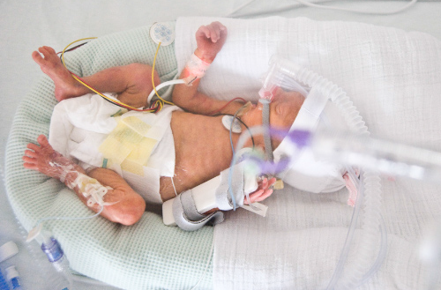
Introduction - Neonates
The WHO defines preterm birth as the delivery of an infant between 20 and 37 weeks of gestation.
Mean preterm birth rates have been reported as 5-11% in the Western population [1].
Technological and pharmacological advances have resulted in both earlier delivery and increased survival rates [2].
Although skin care has been recognized as a key element of practice little research has been conducted and clinical management is still commonly based on tradition

Slide 3
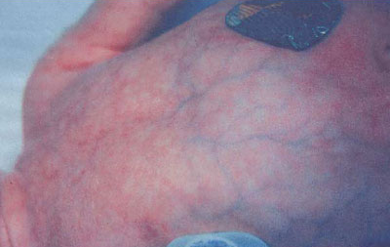
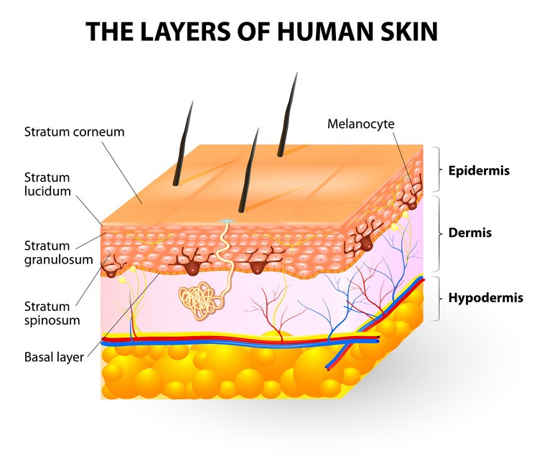
Why is Skin important in Neonates?
The skin barrier begins to function in utero, at 24 weeks’ gestation, the skin appears red, wrinkled, shiny, and transparent
The associated stratum corneum (SC) is only one or two cell layers thick, and dermal elastic fibres are sparse in distribution [3].
In addition, the integrity of the dermal–epidermal junction is poorly developed.
Each of these factors contribute to abnormal skin physiology

Slide 4
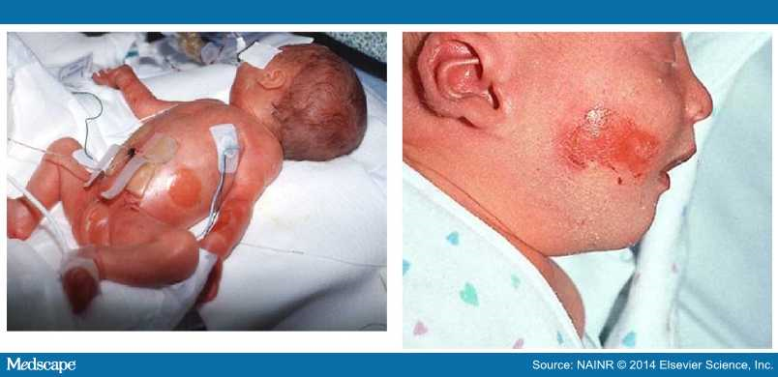
Skin Damage and Neonates
Skin damage is one of the most common iatrogenic injuries occurring in as many as 24% of NICU patients [11].
The literature has reported several different mechanisms of skin damage, including
  diaper dermatitis [12],
  taping/adhesive injury [13],
  extravasation injury [14],
  thermal injury [15]
  and pressure ulcers [16].

Slide 5
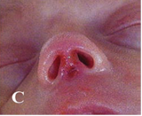
Neonates and Pressure Ulcers
PUs in neonates have a reported prevalence rates as high as 23% [16].
A key reasons for these prevalence rates is the use of equipment and devices, which is implicated in more than 50% of PUs in neonates [5].
An example of these devices is nasal continuous positive airway pressure (nCPAP). Recent evidence highlighted an incidence of 40%.
The high incidence of trauma has been correlated with low gestational age and birth weight [21].
The consequence of the trauma has, in some cases, necessitated cosmetic/functional surgery [23].

Slide 6
Device related skin Damage
Device | Type of damage | References
nCPAP (prongs and mask delivery systems) | Pressure ulcers, septal erosion, unspecified nasal damage | (Alsop et al. 2008; Buettiker et al. 2004; Robertson et al. 1996; Fischer et al. 2010)
nCPAP hats | Forehead necrosis | (Hogeling et al. 2012)
Intravenous and intra-arterial catheters | Extravasation injury, needlemarks | (Wilkins & Emmerson 2004; Fox & Rutter 1998)
Oxygen cannulae | Nasal mucosal damage | (Kopelman & Holbert 2003)
Cooling jackets | Subcutaneous fat necrosis, necrotic skin lesions | (Fumagalli et al. 2011; Oza et al. 2010; Demirel et al. 2013)
Transilluminators | Burns | (Perman & Kauls 2007; Keroack et al. 1996)
Phototherapy lamps | Burns | (Siegfried et al. 1992)
Adhesive tape | Disruption of barrier function | (Lund et al. 1997)
ET tubes (oral and nasal) | Pressure ulcers | (Fujioka et al. 2008)
Chest drains | Long-term scarring (initial damage not described) | (Fox & Rutter 1998)
Warming devices (e.g. heating lamps, water bottles) | Burns | (Rimdeika & Bagdonas 2005; Simonsen et al. 1995; Möhrenschlager et al. 2003)
Notes:
Something that is currently lacking is figures for ALL skin damage in neonates, not just PUs. There have occasionally been inconsistencies around including/not including MDRUs in prevalence studies, and certainly a lot of non-PU device-related damage is not picked up in previous prevalence studies. There have been case reports of many kinds of skin damage in this population as you can see, and

Slide 7
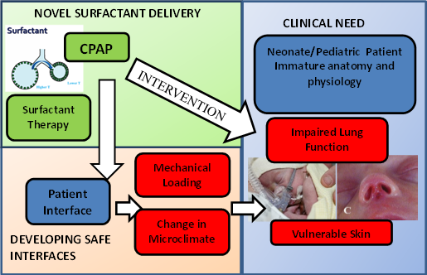
UoS Paediatric Theme
In collaboration with WoundTech HTC UoS was awarded an NIHR Paediatric Theme grant (May 2016-Dec 2018).
Prof Howard Clark (PI), Prof Dan Bader, Dr Peter Worsley
Two core themes:
  Surfactant therapy
  Skin Health

Slide 8
Skin Health Research
A number of skin health activities within the Paediatric Theme
Patient and Public Involvement
A survey of neonatal nursing practice in the Thames Valley & Wessex Neonatal Operational Delivery Network
A prevalence and Incidence Study of skin damage in Neonates, specifically aligned to medical devices
An evaluation of Skin Maturation in Neonates
In-silico evaluation of respiratory mask design for vulnerable neonates

Slide 9
Patient and Public Engagement
Child was born 17th Jan 2014 and was in NICU for 20 weeks.
Under went PDA (Patent Ductus Arteriosus) ligation as heart duct still open. Then very unwell at two weeks old with a perforated bowel, stoma and necrotising enterocolitis.
Child was ventilated at 9 weeks, followed by a course of steroids, then moved to CPAP, then optiflow.

Slide 10
Medical Device Related Injuries
Scarring from sats probe on hand from measuring arterial oxygen saturation
Scarring on his back from his sats probe/hand being caught behind him and not moved
On his ankle from plastic name badge. Plastic serrated badge removed skin and rubbed. No need to be plastic, could place on ventilation tubing instead.
Chronic lung disease from tubing from CPAP mask
A nasogastric tube (NG tube) marks behind the head (head plastic tubing)
Also injury from CPAP mask with indentation on the cheeks.

Slide 11
Do you think anything could have been done to prevent this injury?
Prongs are very badly made and now has long term injuries to septum.
The distance is often wrong between the prongs and they don’t sit flat against his nose, but at a right angle and don’t fit in his nostrils.
When his nose is wet, it rubs against the skin and makes him sore and the oxygen supply doesn’t work.
They also need to look at the materials they use, as they are stiff plastic and would be better if made from silica or another softer material.

Slide 12
Cont.
It is very expensive to buy the prongs, half of them don’t fit properly and have to be thrown away. The tubes also have to be taped very tightly which causes dents in the cheeks.
Prongs also get sticky from the tape attached them and create rashes on cheeks. When he was younger, we couldn't leave him as he would pull prongs out.
Ventilation tubes have damaged his vocal chords and caused scarring so he can’t talk. This damage also causes him to choke on fluids. When he is ill he struggles to breathe and drink.
The ventilation tube was far too big for him and caused a lot of damage. Ventilation companies need to look at that. Pressure from ventilation has also damaged his lungs.

Slide 13

Survey of neonatal nursing practice
19-part survey distributed online and in paper format
Included multiple choice, ranking, and open-ended questions
Developed following literature review and discussion with groups of neonatal nursing staff
Notes:
Survey was initially distributed online via the lead nurses from each unit within the Wessex and Thames Valley Neonatal Networks—about 16 units. However, response rates were low, and

Slide 14
Results - respondants
56 responses, of which 94.6% were from registered nurses
64.3% of participants had been qualified for more than 10 years
44.6% of participants were band 6 or 7
Notes:
56 responses returned
Band 6 or 7—responsibility to manage and educate other registered staff. Band 5—responsibility to supervise band 4 staff.

Slide 15

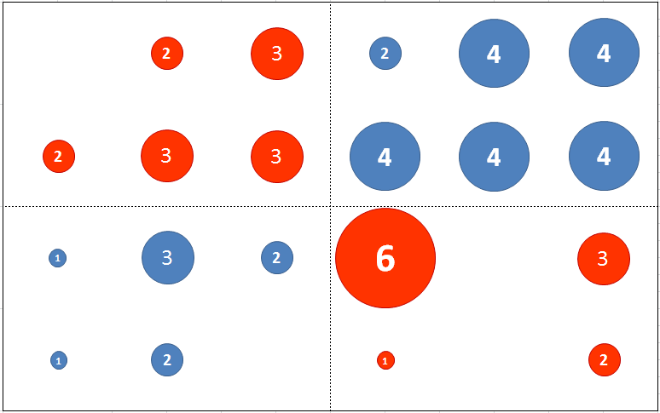
Results – Perceived Risk
Extremely high
Perceived risk of damage
High
Moderate
Slight
Less than once a year
Once or twice a year
Every 2-5 months
Once or twice a month
Weekly
Daily
Perceived frequency of damage
Perceived risk of damage vs perceived frequency of damage
Notes:
56 responses returned
Incidence of skin damage perceived to be high, HOWEVER, disconnect between perception of incidence and perception of risk (people stating that they see damage daily have answered that their patients are anything from “slight risk” to “extremely high risk”)—e.g., most common answer to “How great do you think the risk of skin damage in your patients is?” was “High risk” (20/56); however, that was interpreted to be anything from less than once a year to daily.

Slide 16
Results – Medical Devices
Perceived risk of damage from various medical devices as ranked by participants
Notes:
Other section is largely composed of devices which are relatively rarely used, for example cooling therapy for hypoxic ischaemic encephalopathy, or “bubble” CPAP

Slide 17
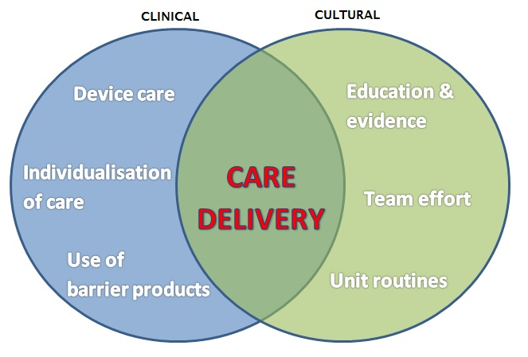
Results - Qualitative
Qualitative themes emerging from free text responses
Notes:
The two strongest themes that came through from the qualitative data were a) device care (i.e. that nurses are having to modify devices in order to make them appropriate for use in their patients), and b) “team effort”, factors such as good handover, asking other staff for advice, using the TVN etc. However, these comments were quite mixed, and

Slide 18
Results - Training
% of participants
Skin care training received

Slide 19
Discussion
Nurses recognize the importance of skin health but lack of training leads to inconsistencies in practice between individuals and units
Skin care practices, especially device modification, are shared person-to-person without systematic evaluation of effectiveness or strong evidence base
Both lack of training and lack of resources need to be addressed through well-conducted research into the causes and risk factors associated with skin breakdown in this population
Notes:
Limitations—recruitment (had to add to recruitment strategy halfway through due to poor response)

Slide 20
Prevalence Study
Report the prevalence of all forms of skin breakdown in hospitalized neonates
Data collected at two neonatal intensive care units
Data collected over two days at each unit, primarily during the medical ward rounds
All forms of skin breakdown recorded
Demographic information and detailed information about care also recorded

Slide 21
Data collection

Slide 22
Results
32 patients observed during data collection
50% of patients had at least one instance of hospital-acquired skin breakdown (n=16/32)
50% of affected patients had skin breakdown associated with medical device use (n=8/16)
23 events observed in 16 patients
Notes:
The data haven’t yet been stratified for gestational age, but this will be the next step.
“Associated with medical device use” includes irritation from devices, MDRUs, indentation without erythema, and extravasation/phlebitis
Every patient had at least one device in place. One intensive care patient had eight.
There were some surprises in terms of the devices that were associated with skin damage—for example, one full-term baby had a pressure ulcer associated with her cord clamp, and one had a pressure ulcer from an ECG lead.
Median number of devices per patient was 3
6 different devices found to be associated with skin damage in this small sample
One baby had both immobility-related and device-related pressure ulcers

Slide 23
Causes of Skin Damage
e.g. umbilical cord clamps, ECG leads, and nasogastric tubes
Types of skin breakdown observed (all events, n=23)
Notes:
Skin irritation here includes reactions to both devices and prophylactic dressings
In one instance a neonate had non-blanching erythema with no clear cause
Pressure “damage” here includes grade I PUs and indentation with no erythema
I was surprised by the relative lack of damage from CPAP—however, talking to the staff there, they seem anecdotally to be moving away from the widespread use of CPAP. I saw three babies on CPAP and it wasn’t associated with skin damage in any of them.

Slide 24
Incidence Study
Report the prevalence of all forms of skin breakdown in hospitalized neonates
Data collected at two neonatal intensive care units
Data collected over 3 months at each unit, primarily during the medical ward rounds (twice per week) Sept 2016-April 2017
All forms of skin breakdown recorded
Demographic information and detailed information about care also recorded

Slide 25
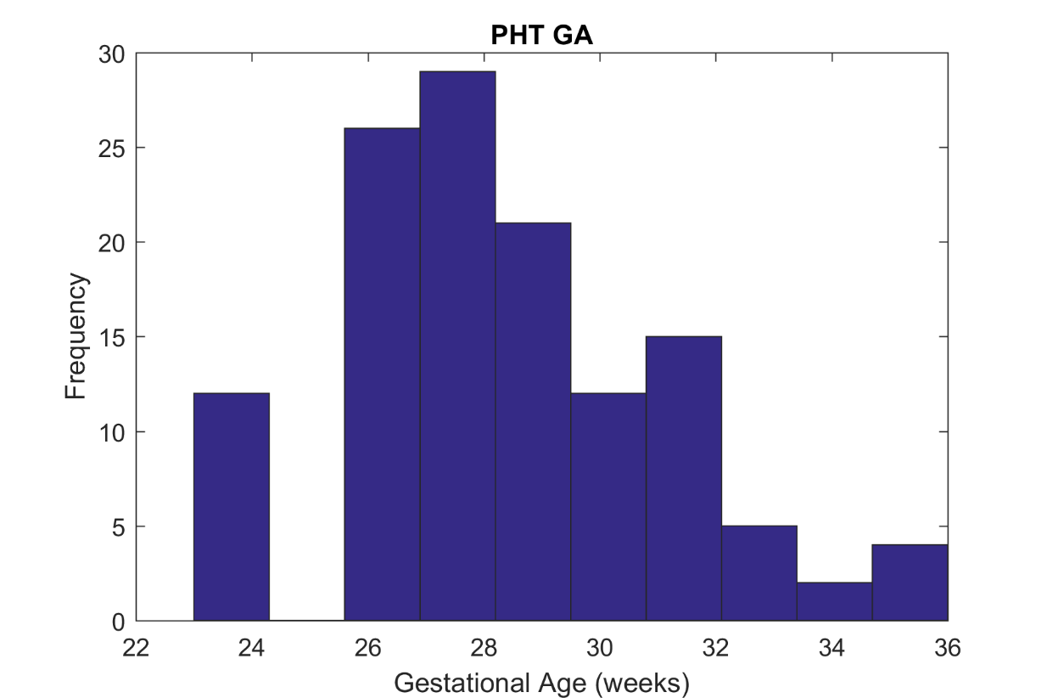
Preliminary findings
The average gestational age of the infants was 28 (range 23-36) and 29 (range 23-38) weeks gestation for PHT and UHS respectively.
Notes:
The data haven’t yet been stratified for gestational age, but this will be the next step.
“Associated with medical device use” includes irritation from devices, MDRUs, indentation without erythema, and extravasation/phlebitis
Every patient had at least one device in place. One intensive care patient had eight.
There were some surprises in terms of the devices that were associated with skin damage—for example, one full-term baby had a pressure ulcer associated with her cord clamp, and one had a pressure ulcer from an ECG lead.
Median number of devices per patient was 3
6 different devices found to be associated with skin damage in this small sampl
One baby had both immobility-related and device-related pressure ulcers

Slide 26
Medical Device Interventions
Intervention | Site 1 (%) | Site 2 (%)
CPAP | 14.3 | 2.5
ETT | 14.3 | 5
NGT | 77.1 | 92.5
UVC | 0 | 7.5
Cannulae | 40 | 40
Stoma | 2.9 | 0
Cooling | 0 | 0
HF | 28.6 | 22.5
LF | 31.4 | 35
Urinary Catheter | 0 | 0
SPO | 80 | 87.5
ECG | 54.3 | 47.5
Long line | 25.7 | 35

Slide 27
Incidence of Skin Damage
Skin Damage | Site 1 (%) | Site 2 (%)
Damage Total | 48.6 | 65
PU (Grade I-II) | 25.7 | 37.5
DD | 28.5 | 35
Chemical | 0 | 2.5

Slide 28
Discussion
Skin damage was observed in over half the infants we studied in the prevalence and incidence study
This was predominantly associated with skin dermatitis and pressure ulcers
Medical devices were observed to be the cause of at least 50% of the pressure ulcers
The majority of injuries ~75% occurred in infants <30 weeks gestation (more vulnerable)

Slide 29
Our Challenge
Neonatal devices need to be fit for purpose
Bottom up approach is required accounting for the different morphology and structure/function of the skin in neonates
More education is required so medical staff are aware of the issue and report problems
We need to lobby key agencies and industry to improve medical device design and invest in appropriate materials
More research is required to define design platforms which can inform this process and test new devices.

Slide 30
Any Questions?

Slide 31
References
Alsop, E.A. et al., 2008. Nasal trauma in preterm infants receiving nasal continuous positive airway pressure. Archives of disease in childhood, 93(Supplement 2), p.n23.
Baharestani, M. M., and Ratfliff, C. (2007) ‘Pressure ulcers in neonates and children: An NPUAP White Paper’, Advances in Skin and Wound Care, 20(4): 208-20
Buettiker, V. et al., 2004. Advantages and disadvantages of different nasal CPAP systems in newborns. Intensive care medicine, 30(5), pp.926–30.
Demirel, G. et al., 2013. Local skin injury as a complication of whole body cooling for perinatal asphyxia. Archives of disease in childhood. Fetal and neonatal edition, 98(2), pp.F150–1.
Fischer, C. et al., 2010. Nasal trauma due to continuous positive airway pressure in neonates. Archives of disease in childhood. Fetal and neonatal edition, 95(6), pp.F447–51.
Fox, P.E. & Rutter, N., 1998. The childhood scars of newborn intensive care. Early human development, 51(2), pp.171–7.
Fumagalli, M. et al., 2011. Total body cooling: skin and renal complications. Archives of disease in childhood. Fetal and neonatal edition, 96(5), p.F377.

Slide 32
References
Fujioka, M. et al., 2008. Upper lip pressure ulcers in very low birth weight infants due to fixation of the endotracheal tube. Journal of Neonatal Nursing, 14(6), pp.207–210.
Hogeling, M. et al., 2012. Forehead pressure necrosis in neonates following continuous positive airway pressure. Pediatric dermatology, 29(1), pp.45–8.
Legault, M., and Goulet, C. (1995) Comparison of kangaroo and traditional methods of removing preterm infants from incubators. Journal of Obstetric, Gynecologic, and Neonatal Nursing, 24(6): 501-6
Ligi, I., Arnaud, F., Jouve, Tardieu, S., Sambuc, R., and Simeoni, U. (2008) ‘Iatrogenic events in admitted neonates: a prospective cohort study’, Lancet, 371(9610): 404-10
Keroack, M.A., Kotilainen, H.R. & Griffin, B.E., 1996. A cluster of atypical skin lesions in well-baby nurseries and a neonatal intensive care unit. Journal of perinatology : official journal of the California Perinatal Association, 16(5), pp.370–3
Kopelman, A.E. & Holbert, D., 2003. Use of oxygen cannulas in extremely low birthweight infants is associated with mucosal trauma and bleeding, and possibly with coagulase-negative staphylococcal sepsis. Journal of perinatology : official journal of the California Perinatal Association, 23(2), pp.94–7.

Slide 33
References
Lund, C.H. et al., 1997. Disruption of barrier function in neonatal skin associated with adhesive removal. The Journal of Pediatrics, 131(3), pp.367–372.
Möhrenschlager, M. et al., 2003. Iatrogenic burns by warming bottles in the neonatal period: report of two cases and review of the literature. The Journal of burn care & rehabilitation, 24(1), pp.52–5; discussion 49.
Ness, M., Davis, D., and Carey, W. (2013) ‘Neonatal skin care: a concise review’, International Journal of Dermatology, 52(1): 14-22
Oza, V. et al., 2010. Subcutaneous fat necrosis as a complication of whole-body cooling for birth asphyxia. Archives of dermatology, 146(8), pp.882–5
Perman, M.J. & Kauls, L.S., 2007. Transilluminator burns in the neonatal intensive care unit: a mimicker of more serious disease. Pediatric dermatology, 24(2), pp.168–71.
Rimdeika, R. & Bagdonas, R., 2005. Major full thickness skin burn injuries in premature neonate twins. Burns : journal of the International Society for Burn Injuries, 31(1), pp.76–84.

Slide 34
References
Robertson, N.J. et al., 1996. Nasal deformities resulting from flow driver continuous positive airway pressure. Archives of disease in childhood. Fetal and neonatal edition, 75(3), pp.F209–12.
Siegfried, E.C., Stone, M.S. & Madison, K.C., 1992. Ultraviolet light burn: a cutaneous complication of visible light phototherapy of neonatal jaundice. Pediatric dermatology, 9(3), pp.278–82.
Simonsen, K. et al., 1995. Iatrogenic radiant heat burns in severely asphyxic newborns. Acta Paediatrica, 84(12), pp.1438–1440.
Wilkins, C.E. & Emmerson, A.J.B., 2004. Extravasation injuries on regional neonatal units. Archives of disease in childhood. Fetal and neonatal edition, 89(3), pp.F274–5

